Slide 1
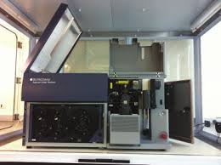
Sorter #1 HOOD ARIA 2V-4B-2R
Detectors
VIOLET
407
BV421
PACBLUE
DAPI
BV510
AMCYAN
CFP
FITC
GFP
ALEXA488
PE
DSRED
PETXRED
PI
PE-CY7
Lasers
BLUE
488
PE-CY5
PER-CY5.5
APC-Y7
RED
640
APC ALEXA647

Slide 2
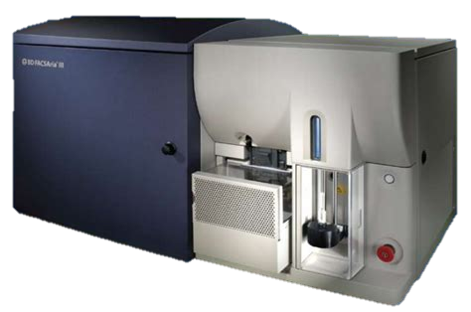
Sorter #2 Self Aria 2U-5V-2B-4Y-3R
Detectors
BUV396
DAPI
CFP
HOESCHT
RED
UV
355
CFP
449
BV510
AMCYAN
CFP
BV605
QDOT 605
BV711
BV750
VIOLET 407
BV421
PACBLUE
BV660
Lasers
FITC
GFP
ALEXA488
BLUE
488
PER-CY5.5
Y/G
568
PE
DSRED
PETXRED
PI
MCHERRY
PE-CY7
PE-CY5
AP-CY7
RED
633
APC ALEXA647
A700

Slide 3
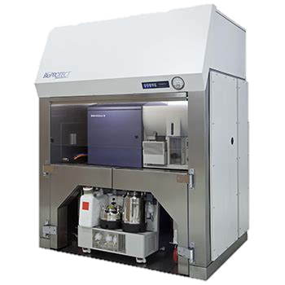
Sorter #3 CLS ARIA 2V-2B-4Y-2R
Detectors
VIOLET
407
BV421
PACBLUE
DAPI
BV510
AMCYAN
CFP
FITC
GFP
ALEXA488
BLUE
488
PER-CY5.5
Lasers
Y/G
568
PE
DSRED
PETXRED
PI
MCHERRY
PE-CY7
PE-CY5
AP-CY7
RED
640
APC ALEXA647

Slide 4
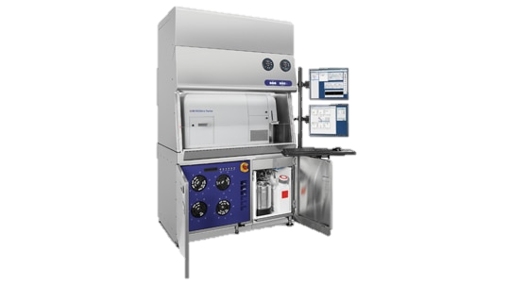
Sorter #4 FUSION ARIA 3V-2B-4Y-2R
Detectors
VIOLET
407
BV421
PACBLUE
DAPI
BV510
AMCYAN
CFP
BV750
FITC
GFP
ALEXA488
Lasers
BLUE
488
PER-CY5.5
Y/G
568
PE
DSRED
PETXRED
PI
MCHERRY
PE-CY7
PE-CY5
AP-CY7
RED
640
APC ALEXA647

Slide 5
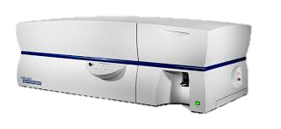
Analyzer #1 LSR-ii 2U-6V-2B-4Y-3R
Detectors
UV 355
BUV396
DAPI
HOESCHT
RED
DAPI
VIOLET 407
BV510
AMCYAN
CFP
BV711
BV750
BV421
PACBLUE
BV605
QDOT 605
BV660
Lasers
FITC
GFP
ALEXA488
BLUE
488
PER-CY5.5
PE
DSRED
PETXRED
PI
MCHERRY
PE-CY7
Y/G568
PE-CY5
AP-CY7
RED
640
APC ALEXA647
A700

Slide 6
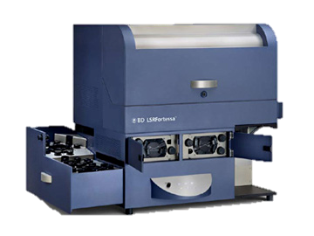
Analyzer #2 FORTESSA 8th 6V-2B-4Y-3R
Detectors
VIOLET
407
BV421
PACBLUE
DAPI
BV510
AMCYAN
CFP
BV605
QDOT 605
BV750
BV660
BV711
FITC
GFP
ALEXA488
BLUE
488
PER-CY 5.5
Lasers
PE
DSRED
PETXRED
PI
MCHERRY
PE-CY7
Y/G
568
PE-CY5
AP-CY7
RED
640
APC ALEXA647
ALEXA700

Slide 7
Analyzer #3 FORTESSA 6th 4U-5V-2B-4Y-3R
Detectors
UV 355
BUV396
DAPI
BUV496
BUV 661
BUV 737
BV421
PACBLUE
BV510
AMCYAN
CFP
BV605
QDOT 605
BV711
BV750
VIOLET 407
Lasers
FITC
GFP
ALEXA488
BLUE
488
PER-CY5.5
PETXRE
PI
MCHERRY
PE-CY7
Y/G
568
PE
DSRED
PE-CY5
RED
640
APC
ALEXA647
AP-CY7
A700

Slide 8
Sorter #1 HOOD ARIA 2V-4B-2R
Technical Specifications
Quartz cuvette flow cell is gel-coupled by refraction index-matching optical gel to the florescent objective lens. Sort fractions collected jet-air
3 laser
11 parameters: 9 fluorescent and two scatter parameters + Time
Sheath pressure is adjustable from 20,35,70 PSI at normal operation
Maximum of 4 way sort fractions
Aerosol Management Option(AMO) with Bio-Bubble negative pressure
Bio Safety Level 2+ environment
262,144 channel(18bit) dynamic range on all parameters
Window xp-Pro OS, Diva software acquisition

Slide 9
Sorter #2 Self Aria 2U-5V-2B-4Y-3R
Technical Specifications
Quartz cuvette flow cell is gel-coupled by refraction index-matching optical gel to the florescent objective lens. Sort fractions collected jet-air
5 laser-separate interrogation of sample for each laser
18 parameters: 16 fluorescent and two scatter parameters + Time
Sheath pressure is adjustable from 20,35,70 PSI at normal operation
Maximum of 4 way sort fractions
Sample collection cooling 4◦, 20 ◦, 37 ◦, and 42 ◦C(water re-circulator for refrigeration/heating)
Aerosol Management Option(AMO) with Bio-Bubble negative pressure
Bio Safety Level 2+ environment
262,144 channel(18bit) dynamic range on all parameters
Window xp-Pro OS, Diva software acquisition

Slide 10
Sorter #3 CLS ARIA 2V-2B-4Y-2R
Technical Specifications
Quartz cuvette flow cell is gel-coupled by refraction index-matching optical gel to the florescent objective lens. Sort fractions collected jet-air
3 laser
11 parameters: 9 fluorescent and two scatter parameters + Time
Sheath pressure is adjustable from 20,35,70 PSI at normal operation
Maximum of 4 way sort fractions
Aerosol Management Option(AMO) with Bio-Bubble negative pressure
Bio Safety Level 2+ environment
262,144 channel(18bit) dynamic range on all parameters
Window xp-Pro OS, Diva software acquisition

Slide 11
Sorter #4 FUSION ARIA 3V-2B-4Y-2R
Technical Specifications
Quartz cuvette flow cell is gel-coupled by refraction index-matching optical gel to the florescent objective lens. Sort fractions collected jet-air
4 laser
16 parameters: 14 fluorescent and two scatter parameters + Time
Sheath pressure is adjustable from 20,35,70 PSI at normal operation
Maximum of 4 way sort fractions
Aerosol Management Option(AMO) with Bio-Bubble negative pressure
Bio Safety Level 2+ environment
262,144 channel(18bit) dynamic range on all parameters
Window xp-Pro OS, Diva software acquisition

Slide 12
Analyzer #1 LSR-ii 2U-6V-2B-4Y-3R
Technical Specifications
5 laser, separate interrogation of sample for each laser
17 color detection + 2 scatter parameters (from 488nm)
Hydrodynamically focused sample interrogated within a quartz cuvette flow cell
Sample aspiration rates at 12ul, 35ul, 60ul per minute
262,144 channel(18bit) dynamic range on all parameters
PC Window XP, Diva version 613

Slide 13
Analyzer #2 FORTESSA 8th 6V-2B-4Y-3R
Technical Specifications
4 laser, separate interrogation of sample for each laser
11 color detection + 2 scatter parameters (from 488nm)
Hydrodynamically focused sample interrogated within a quartz cuvette flow cell
Sample aspiration rates at 12ul, 35ul, 60ul per minute
262,144 channel(18bit) dynamic range on all parameters
PC Window XP, Diva version 6.3

Slide 14
Analyzer #3 FORTESSA 6th 4U-5V-2B-4Y-3R
Technical Specifications
5 laser, separate interrogation of sample for each laser
11 color detection + 2 scatter parameters (from 488nm)
Hydrodynamically focused sample interrogated within a quartz cuvette flow cell
Sample aspiration rates at 12ul, 35ul, 60ul per minute
262,144 channel(18bit) dynamic range on all parameters
PC Window XP, Diva version 613

Slide 15
FLOW
CYTOMETRY
RESEARCH
LAB
F
L
O
W
C
Y
T
O
M
E
T
R
Y
L
A
B
O
R
A
T
O
R
Y
R
E
S
E
A
R
C
H

Slide 16
Analyzer #3 FORTESSA 6th CONFIG
Detectors
UV
BUV396
BUV496
BUV 661
BUV 737
BV711
VIOLET
BV 421
BV510
BV605
BV750
Lasers
BLUE
FITC
PER-CY
5.5
Y/G
PE
PETXRED
PE-CY5
PE-CY7
RED
APC
A700
AP-CY7

Slide 17
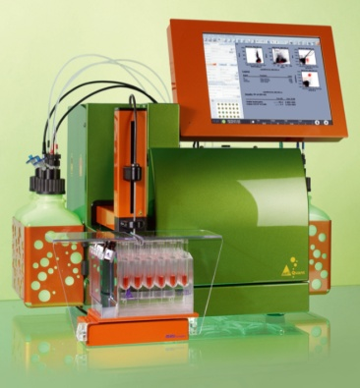
MACSVYB 2V-2B-4Y
Detectors
VIOLET
407
BV421
PACBLUE
DAPI
BV510
AMCYAN
CFP
Lasers
FITC
GFP
ALEXA488
BLUE
488
PETXRED
PI
APC-CY7
PE-CY7
PE
DSRED
APC
PE-CY 5
Y/G
568

