Slide 1
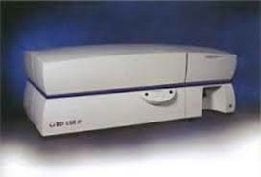
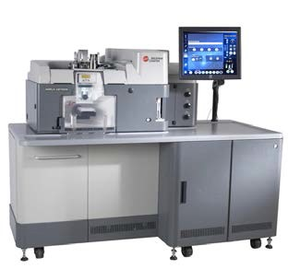
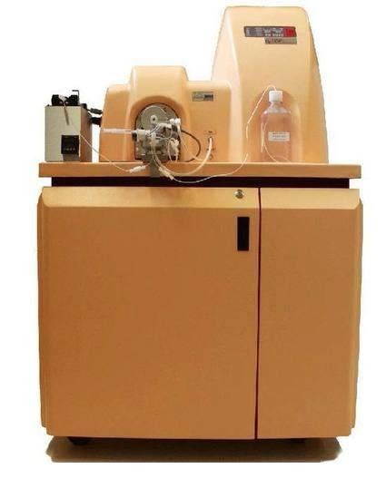
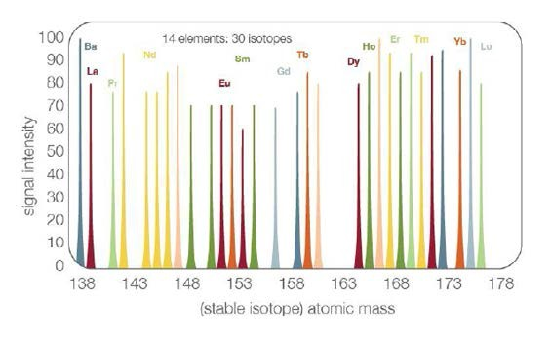
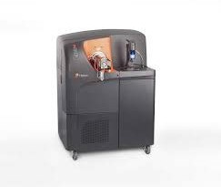
Flow CytoMEtRy AnD MAss CytoMEtRy CoRE (CVD)
CiBR: Center for innovative Biomedical Resources
CoRE instRUMEntAtion
BD LSR II Flow Cytometer
Mission
To ensure that University of Maryland investigators have access to flow cytometry and mass cytometry services for their research. A facility with dedicated operators ensures well-performing instruments and optimal results with a minimal outlay of expenses. Established in 1991, this facility has state-of-the art equipment and a highly-trained and experienced staff.
• 4 lasers: 407, 488, 552, and 641 nm
16 parameters (14 colors plus forward and side scatter)
Beckman Coulter MoFlo Astrios Cell Sorter
• 4 lasers: 355, 407, 488, and 641 nm
21 parameters (19 colors plus forward and side scatter)
Up to 6-way high speed sorting
CyCLONE single cell sorting
CoRE sERViCEs
Multichromatic flow cytometry
Including markers for:
Lineage
Maturation
Activation
Homing
Intracellular cytokines
Fluidigm CyTOF Mass Cytometer
>35 parameters based on mass spectrometry detection of metal isotope-labeled antibody staining
No need for single color controls or fluorescence compensation
Cell sorting (up to 6-way) based on GFP and/or multichromatic staining
Mass Cytometry (>60 parameters)
Serum/supernatant cytokine levels using bead kits (e.g. BD Pharmingen CBA kit)
Cell cycle analysis (PI, DAPI)
Cell proliferation (CFSE, PCNA, BrdU and Ki67)
Apoptosis (Annexin V vs. PI; TUNEL; subG0/G1 peak analysis)
Green fluorescence protein (GFP) (eukaryotic and prokaryotic)
Advice with experimental design and data analysis
Fluidigm Helios Mass Cytometer
>60 parameters based on mass spectrometry detection of metal isotope-labeled antibody staining
No need for single color controls or fluorescence compensation

Slide 2
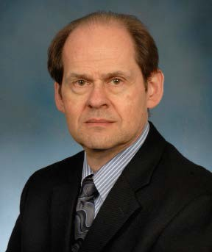
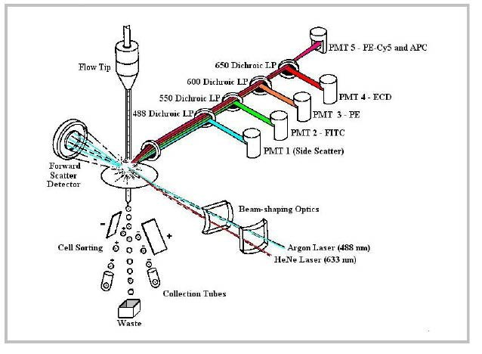
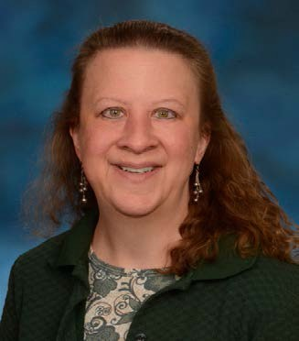
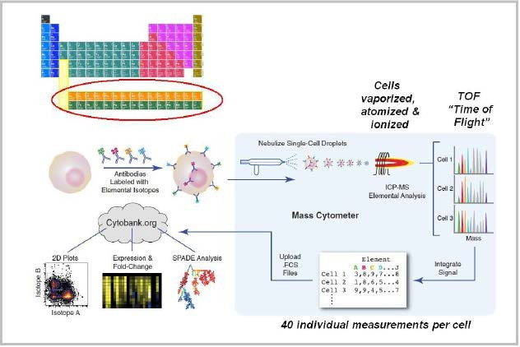
Flow CytoMEtRy AnD MAss CytoMEtRy CoRE (CVD)
CiBR: Center for innovative Biomedical Resources
Principles of Flow Cytometry
ContACt
Fluidics
Cells in a single-cell suspension
Flow in a single file through
Optics
An illuminated volume where they
Scatter light and emit fluorescence
That is filtered, collected and
Electronics
Converted to digital values
That are stored on a computer
And put through software for analysis
Revised from Dr. Robert Murphy, Carnegie Mellon University, Pittsburgh, PA
Marcelo Sztein, MD Laboratory Director
msztein@medicine.umaryland.edu 410-706-2345
Regina Harley, MS Laboratory Supervisor
loCAtion
Room 456, Health Sciences Facility I 685 West Baltimore Street Baltimore, MD 21201
410-706-0095
Fax: 410-706-6205
Principles of Mass Cytometry
Core Email cvdflowcore@medicine.umaryland. edu
web Address http://medschool.umaryland.edu/ orags/flowlab.asp
laboratory Policies
Experiments should preferably be
scheduled one to two weeks in advance.
All sample analysis and cell sorting is done by Core Laboratory personnel.
The “Rules and Regulations” form (Revision March 10, 2015) is available at the CVD Flow Cytometry Core Laboratory.
Bendall & Simonds et al., Science 332, 687 (2011) www.cytobank.org/nolanlab

