Slide 1
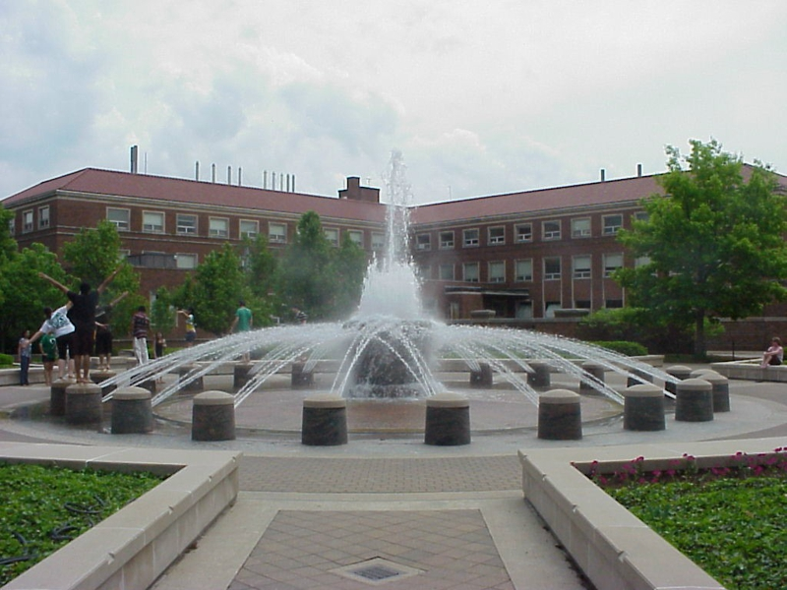
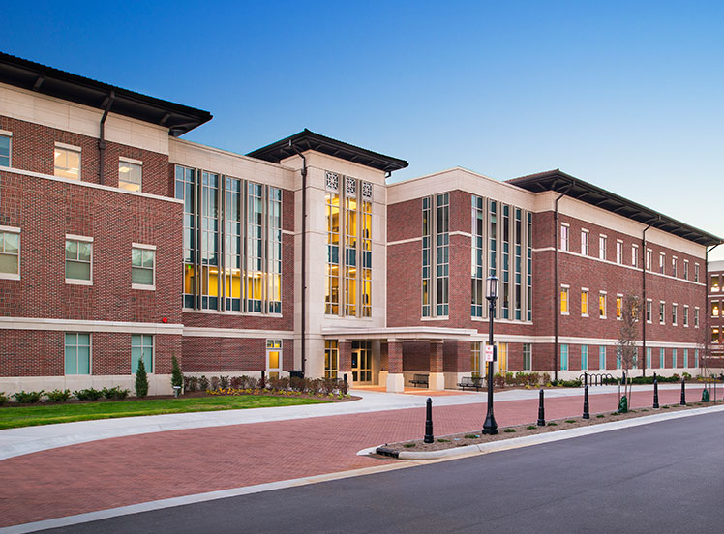
Purdue University – Clinical Research Center (PU-CRC)
Located within the Dept. of Nutrition Sciences
Stone Hall (7,626 sq ft)
Lyles-Porter Hall (4,720 sq ft)
Over 12,000 sq ft
- Metabolic Kitchen
- Dining Facility
- Diet Assessment Center
- Exercise Testing Facility
- Ingestive Behavior Suite
- Bionutrition Services
- Teaching/Demo Kitchen
- Multiple Clinical Testing Suites
- Bone & Body Composition Unit
- Sensory Suite

Slide 2
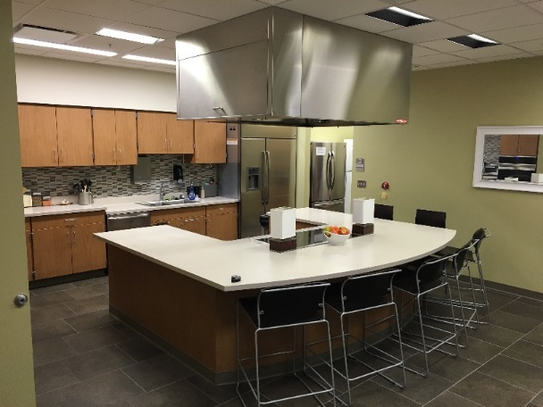
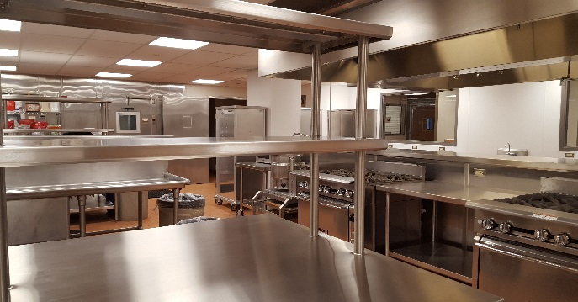
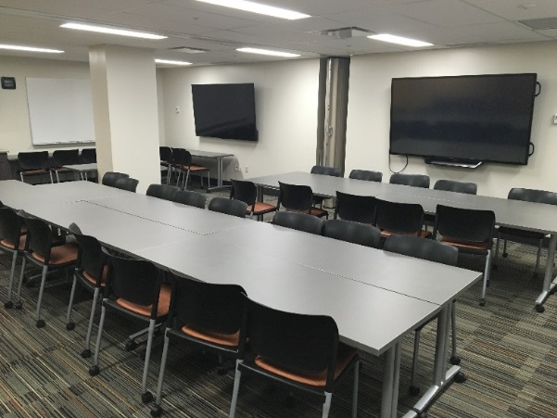
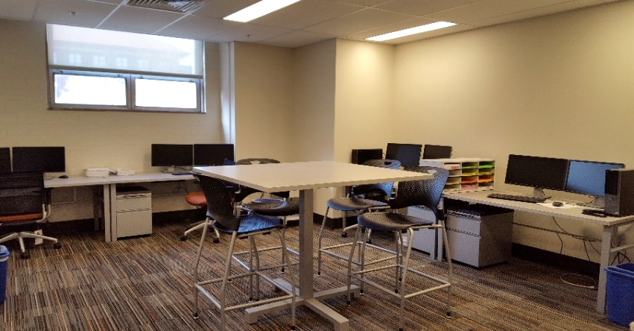
Bionutrition & Dietary Assessment
Teaching/Demo Kitchen
Metabolic Kitchen
Large capacity metabolic kitchen with precise weighing
Up to 25,000 meals/year with up to 50 subjects/day
Dining area for in-house meal consumption & monitoring
Complete tightly controlled feeding studies
Individualized &/or group diet development & meal planning
Full spectrum of dietary assessment methods (i.e., 24-hour recall, frequency methods, records, and screeners)
Guidance on method selection, protocol development, & data analysis
Capabilities to perform nutrition counseling & education
Large Dining Area/Conference Room
Dietary Assessment Center

Slide 3
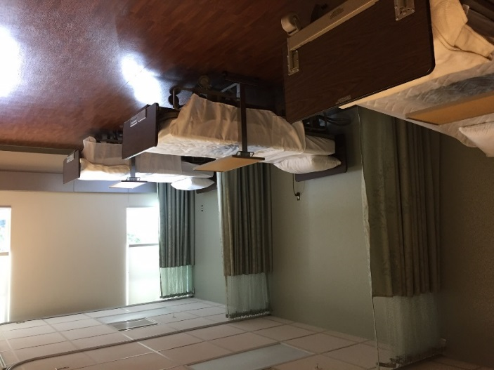
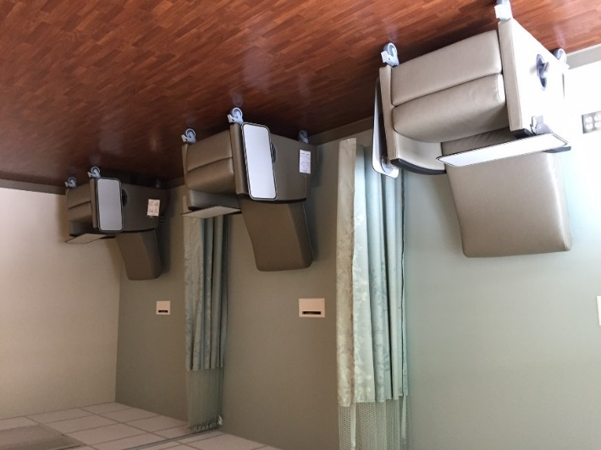
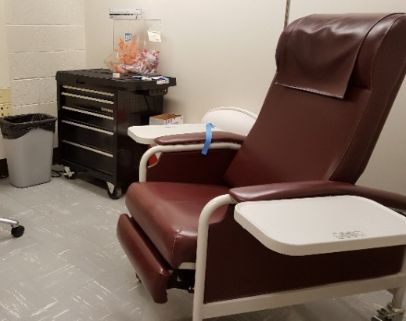
Examples of Clinical Testing Areas
Open, multi-testing areas
Single-room
Large capacity (n=16 chairs/beds) to complete health-related assessments including:
IV placement/access for repeated blood sampling for oral & mix-meal glucose tolerance tests
Blood pressure and heart rate monitoring
Single-stick (fasting) phlebotomy
Point of care testing – glucose and urine pregnancy
Muscle biopsy
Study drug administration
Electromyographic (EMG) recording
Additional facilities to complete other assessments for:
Sensory testing
Surreptitious observation
Appetitive sensations
Select cognitive and psychological testing

Slide 4
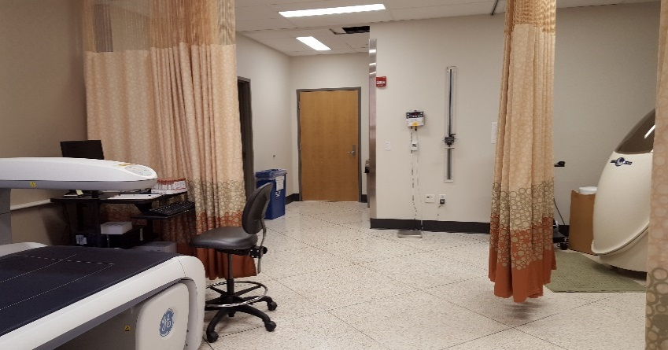
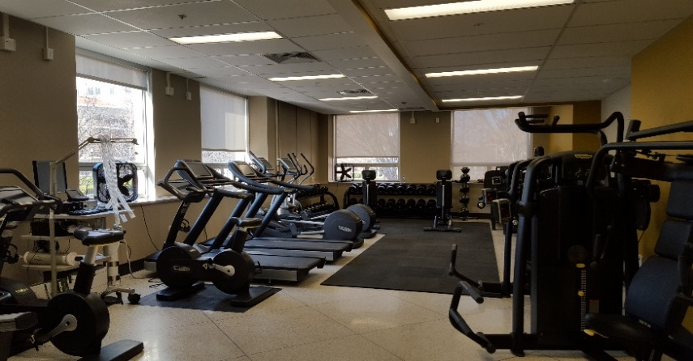
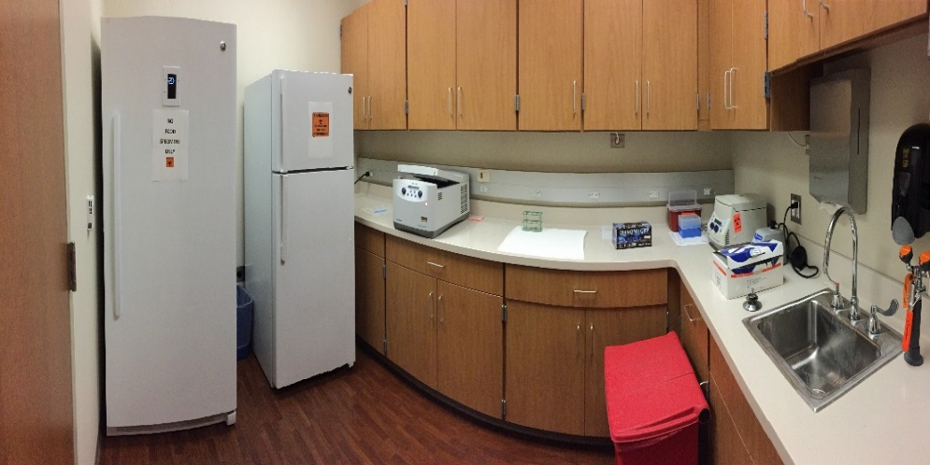
Additional Facilities
Bone & Body Composition Research Core
Exercise Facility
Body composition (Bod-Pod & DXA)
Bone health assessments (DXA, pQCT)
Anthropometrics
Exercise training with state-of-the-art monitoring
Max and sub-max fitness testing
Metabolic assessments
Blood processing areas
Sample Processing

Slide 5
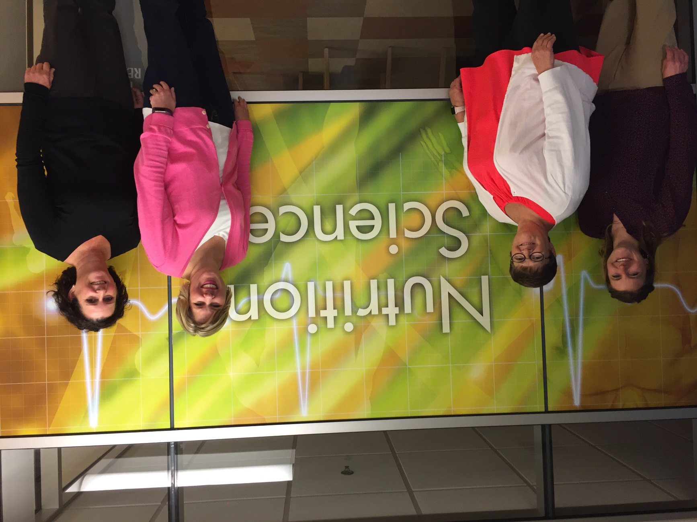
PU-CRC Support
Amy Wright, BS, RD
Bionutrition Manager
Research Dietitian
Robin Rhine, EMT, QMA
Clinical Manager
Anne Wilcox, MS, RD
Research Dietitian
Lana Merrick, BS, CC
Kitchen Supervisor
Culinary Research Chef

Slide 6
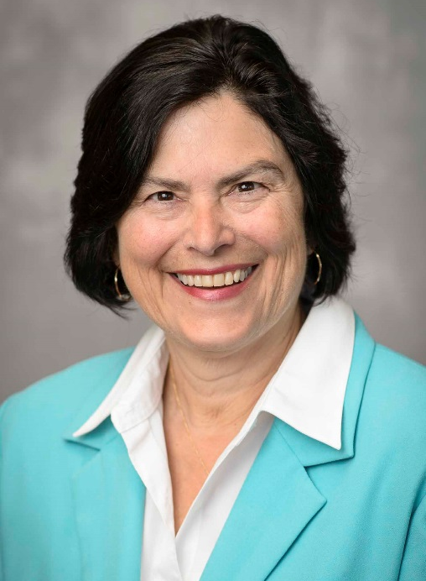
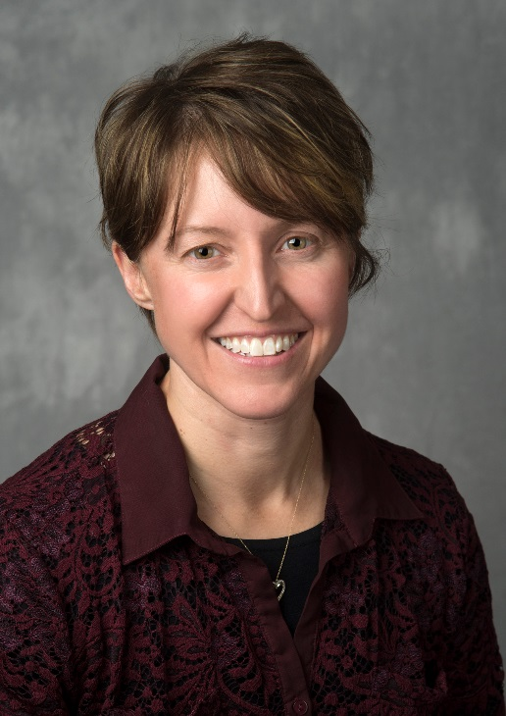
PU-CRC Senior Support
Connie Weaver, PhD
Indiana CTSI Purdue
Deputy Director
Email: weavercm@purdue.edu
Heather Leidy, PhD
Purdue-CRC Director
Email: hleidy@purdue.edu
Regan Bailey, RD, PhD
Dietary Assessment Center Director
Email: reganbailey@purdue.edu
For questions regarding protocol submission, use of CRC space, equipment, and support/services, please contact Dr. Leidy at hleidy@purdue.edu or call 573-825-2620.

