Slide 1
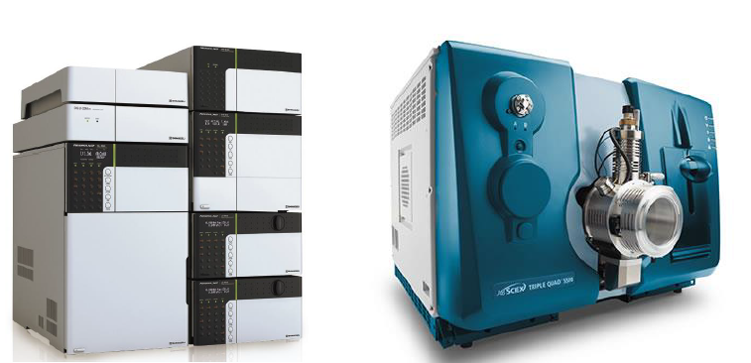
Shimadzu LC Nexera X2 uHPLC coupled with a 5500 AB Sciex QTRAP MS/MS

