Slide 1
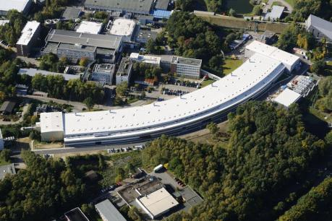
Safety briefing for working in the SPC facility (building 48e)
PETRA III
Building
48e

Slide 2
EMBL Safety Policy
This presentation aims to highlight the main safety rules for users working in the labs in building 48e (SPC and HTX Facility).
EMBL
(25a building)
PETRA III
(building 47c)
EMBL
(48e building)
A print out of the complete Safety Policy for EMBL in Hamburg is available at the SPC Facility for consultation.

Slide 3
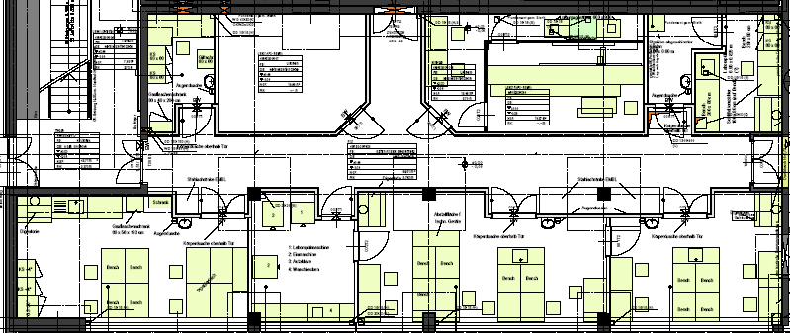

The SPC and HTX Facility
Both facilities are located on the ground floor of building 48e near the PETRA III beamlines.
EMBL
(25a building)
Crystal storage
room (L008b)
Cold room
(L008a)
Crystal storage
(L007)
Derivative laboratory
(L005)
PETRA III
PETRA III
Crystallisation Facility
(L004)
Laboratory kitchen (L003)
Sample Preparation and Characterisation Facility
(L002)

Slide 4

The SPC and HTX Facility
Visitors may have free access to the SPC Facility, cold room and laboratory kitchen.
Crystal storage
room
Cold room
(L008a)
Crystal storage
Derivative laboratory
PETRA III
Crystallisation Facility
Laboratory kitchen
Sample Preparation and Characterisation Facility

Slide 5




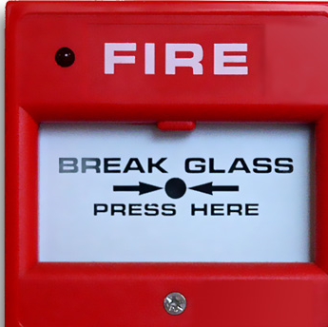
Basic Safety Requirements
Familiarise yourself with the location of the first aid kit, fire extinguisher, safety shower, escape routes and the emergency exits.
window
window
window
window
window
window

Slide 6

Basic Safety Requirements
No smoking is permitted in the EMBL buildings. Smoking is allowed on the terrace of building 48e on the second floor.
Stairways, emergency exits and escape routes must be kept free at all times.
Fire exit doors should remain closed.
Close windows and doors of the laboratories prior to leaving.
Do not endanger others or yourself.
For your own safety, you are only allowed to work alone at night or at weekends if you first have informed your local contact (external visitor) or your group leader (internal users).

Slide 7
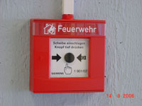
Fire Emergency
Raise the alarm by pressing the nearest fire-alarm button
You may try to extinguish a minor fire, but you must not put yourselves at risk to fight a fire.
Evacuate the building and follow the fire escape plan. Don‘t use the elevator – danger of power failure.

Slide 8
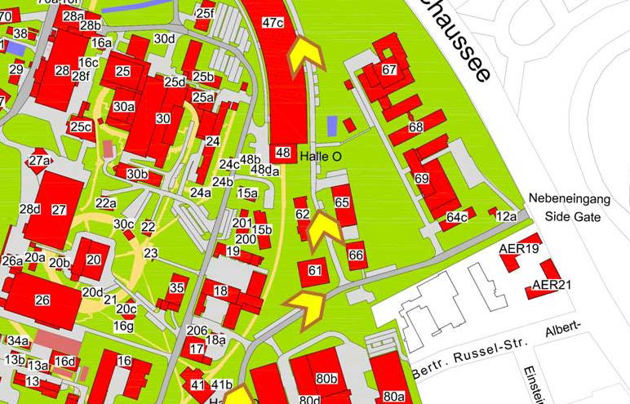


In case of Evacuation
  Exit the building following the escape route signs and proceed to the meeting point. Don‘t run on your way out.
  Follow the instructions of the fire wardens, the DESY emergency response team and the fire brigade.
  Wait to return to the building until authorised by the coordinator at the meeting point.
The location of evacuation assembly area is located in the large parking area in front of building 47c

Slide 9
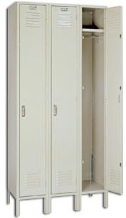

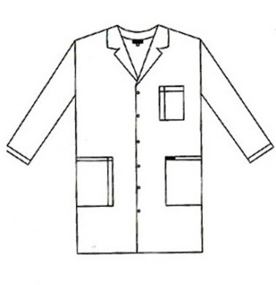

General Laboratory Safety Rules
Coat, bag and luggage must be stored in the lockers available on the ground floor near the SPC Facility.
You are not allowed to eat or drink in the lab. Foods and drinks must never be stored in laboratories and cold rooms.
Lab coats for EMBL staff and visitors are available in the hall near the SPC Facility and are mandatory in the lab.

Slide 10




General Laboratory Safety Rules
We would like to remind you that in all laboratories:
Safety goggles must be worn when handling hazardous chemicals or pathogenic biological agents.

Slide 11


General Laboratory Safety Rules
Depending on the hazard, appropriate gloves must be worn. Gloves must be removed before touching handles, switches, taps or leaving the laboratory.
You should follow the "one-glove" rule: Wear one glove to carry potential harmful material and have one hand without a glove to touch door handles, switches etc.

Slide 12
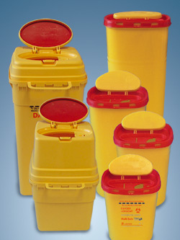
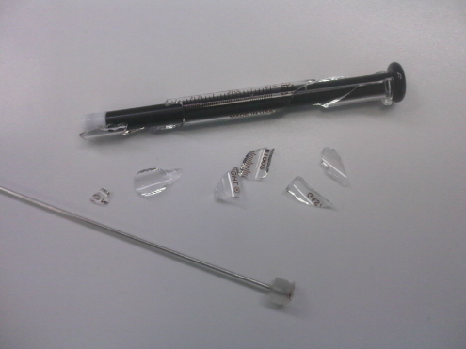
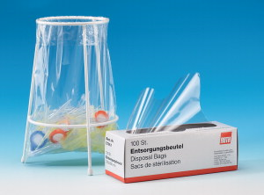
General Laboratory Safety Rules
Sharp objects must be discarded into multi-safe boxes only. Needles should NOT be recapped.
Broken glass should be trashed in the designated containers located in the laboratory kitchen (L003).
Pipettes tip should be trashed in pipette trash bags available on each laboratory bench.

Slide 13

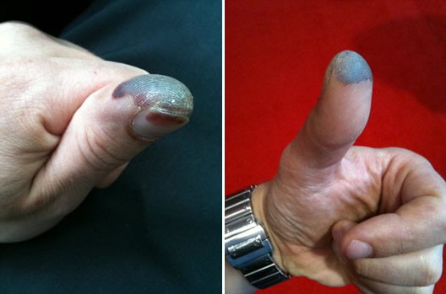
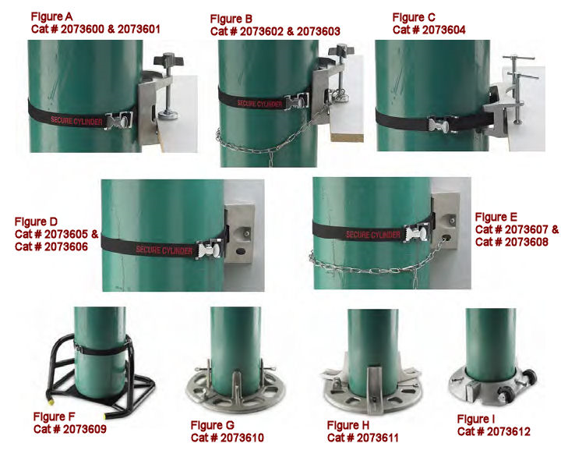
General Laboratory Safety Rules
Handling liquid nitrogen?
-Wear gloves, lab coat and face shield.
-Far from electronic equipment.
-In an open area.
-Do not spill on the floor.
Handling gas cylinders?
-Authorized in the SPC facility, derivative laboratory and the cold room. The use of gas cylinders must be authorized by the SPC staff before the beginning of the experiment. Please note that the users must provide appropriate safety equipment to immobilise the cylinder.

Slide 14












Chemical Safety Rules
You should know and understand risk symbols:
Warning of inflammable matter
Warning of oxidising matter
Warning of
explosives
Warning of
electric current
Warning of
corrosive matter
Warning of harmful or irritant matter
Warning of poisonous matter
Warning of
laser beams
Warning of biohazard
Warning of magnetic field
Warning of compressed air cylinders
Warning of radioactive matter or ionising rays

Slide 15
Chemical Safety Rules
Before using any chemical inform yourself about the risks associated with the chemical and take the appropriate preventative measures. Read the relevant MSDS sheet, available upon request.
Perform all work with hazardous chemicals under the fume hood.
All chemicals have to be properly labelled and stored safely.
Please inform staff members before bringing and using highly toxic and toxic substances in the laboratories. You should handle and store your chemicals under the chemical hood.
(ex: SeMet, azide)
You should dispose of your chemicals appropriately when they are no longer needed or have become unsuitable for use. Please ask a staff member before discarding toxic solvents.

Slide 16
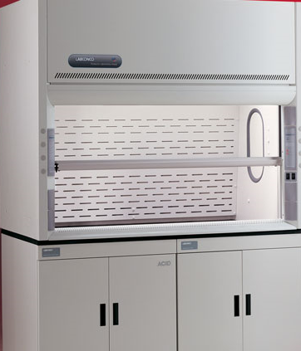
Chemical Safety Rules
Two chemical hoods are available in the SPC
Crystal storage
room
Cold room
Crystal storage
Derivative laboratory
Crystallisation Facility
Laboratory kitchen (L003)
Sample Preparation and Characterization Facility
(L002)

Slide 17
Chemical Safety Rules
Working with acrylamide?
-Work with gloves
-If you want to dispose of non-polymerized acrylamide, add some TEMED and APS, mix and leave it for polymerization. Then dispose of it in the laboratory bins.
-Used tips, pipettes, Falcons etc. should be placed in the laboratory bins.
You should prepare heavy atom solutions and perform derivatization of proteins only in the derivatives laboratory.
Users must ask Michele Cianci for authorization to access to this lab in advance. User will need to follow an additional safety training.
No radioactive compound is allowed in the SPC and HTX Facility.

Slide 18
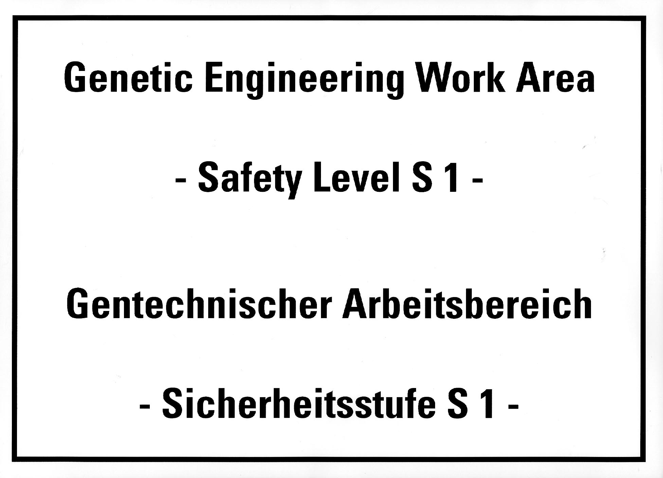
Biological Safety Rules
Before handling intact biological material, you must inform and get the approval of the genetic engineering project leader: Rob Meijers
Only the ground floor of the 48e building is classified as a S1 lab and can be used for organisms and viruses presenting no risk to human health and/or the environment. ex:
E. coli K12 and B strains (all usual expression hosts).
Experimentally proven safe strains.
Genetically modified organisms that are as safe as the S1 host they originate from (e.g. E. coli expressing gene products that are non-hazardous and not virulence factors).
Yeast strains such as S. cerevisiae and P. pastoris.
Eukaryotic cell lines such as HEK293, Sf9, Sf21.
Baculovirus in combination with insect cell lines (Sf9).

Slide 19
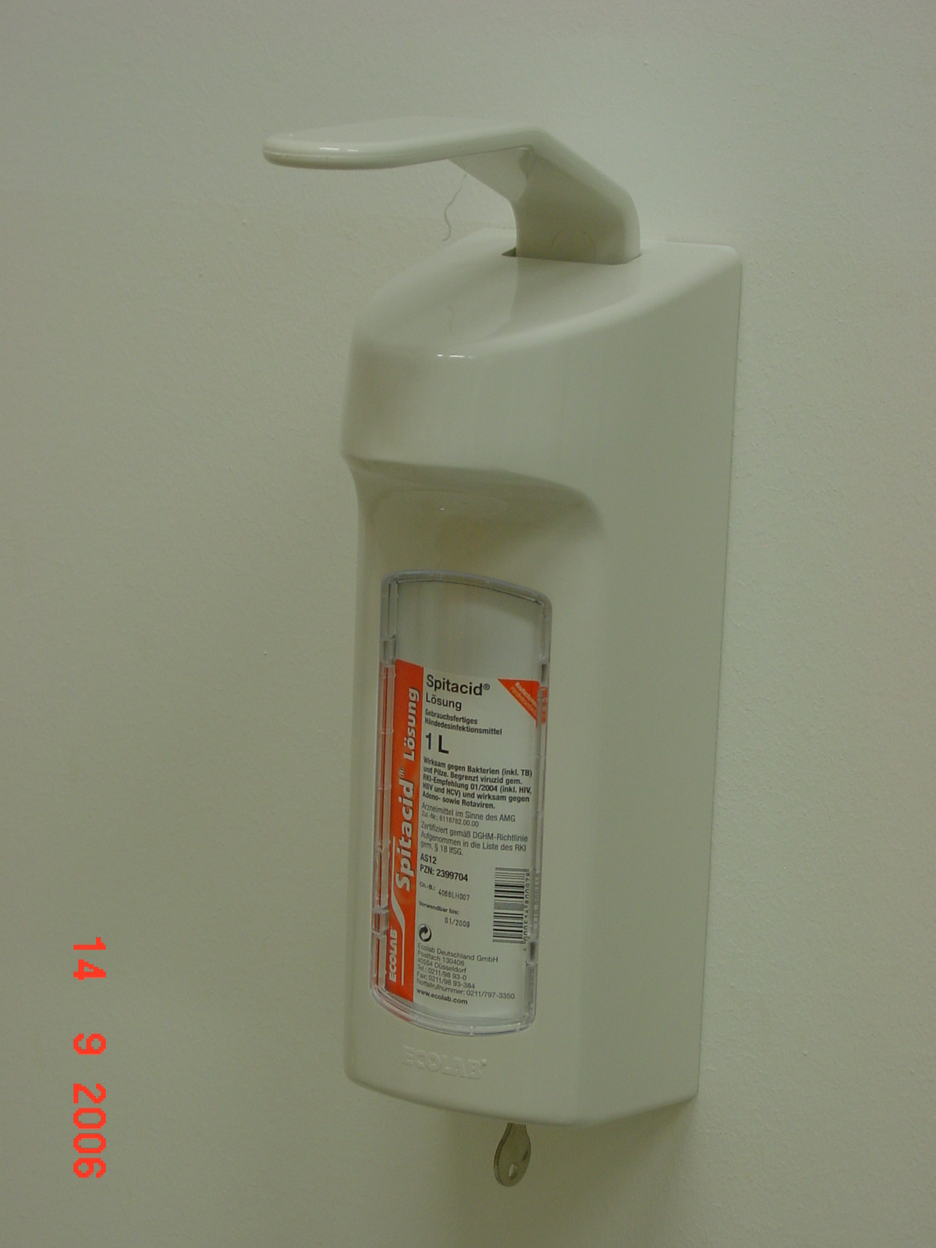
Biological Safety Rules
Avoid producing aerosols when pipetting, shaking, sonifying…
Avoid using syringes and hypodermic needles.
Disinfect and wash hands after finishing work.
Windows and doors should be closed during work.
Surfaces must be disinfected after work.
  Use 70% ethanol for smaller surfaces (< 2 m²).
  Disinfect all materials that have been in contact with cells.
  Soak in Sekusept Plus (1.5% final conc.) for at least 6 hrs.
  Collect waste (e.g. plastic products, paper tissues, tips, etc.) in autoclave bags. Put into the dedicated container in the media kitchen.
  Collect liquid biowaste, add 1.5% Sekusept Plus, and hand to staff.
  Please note that our autoclave is operated by staff members only.

Slide 20
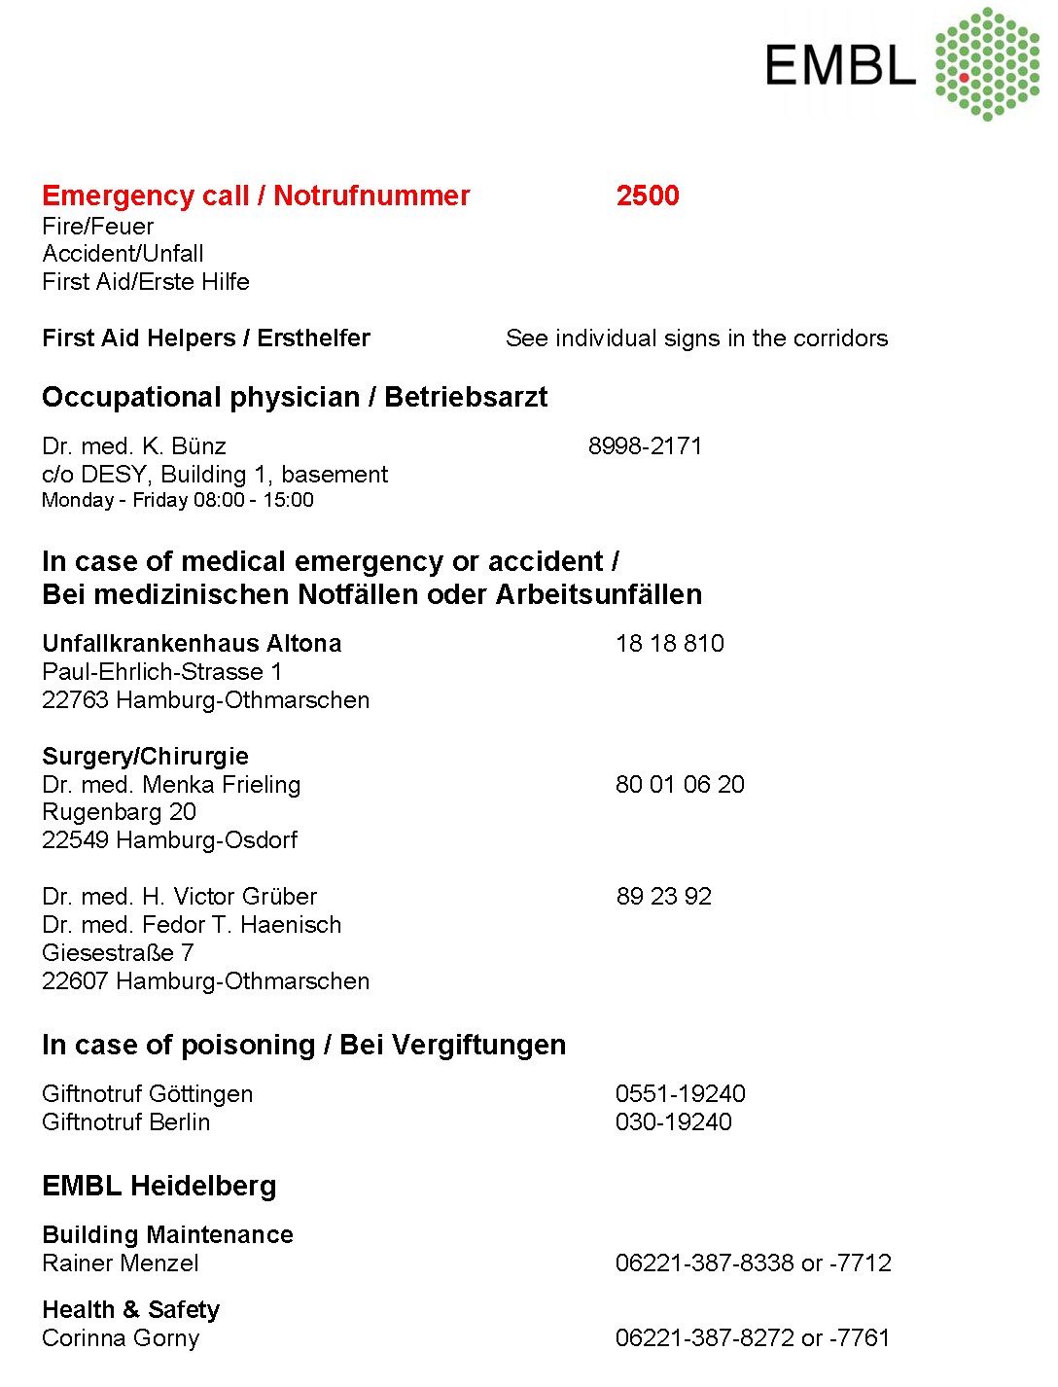

Medical Service: available on site
Location at DESY Campus
Building 1, basement
Tel. 040-8998-2171
Fax 040-8998-4443

Slide 21
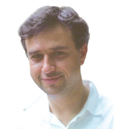


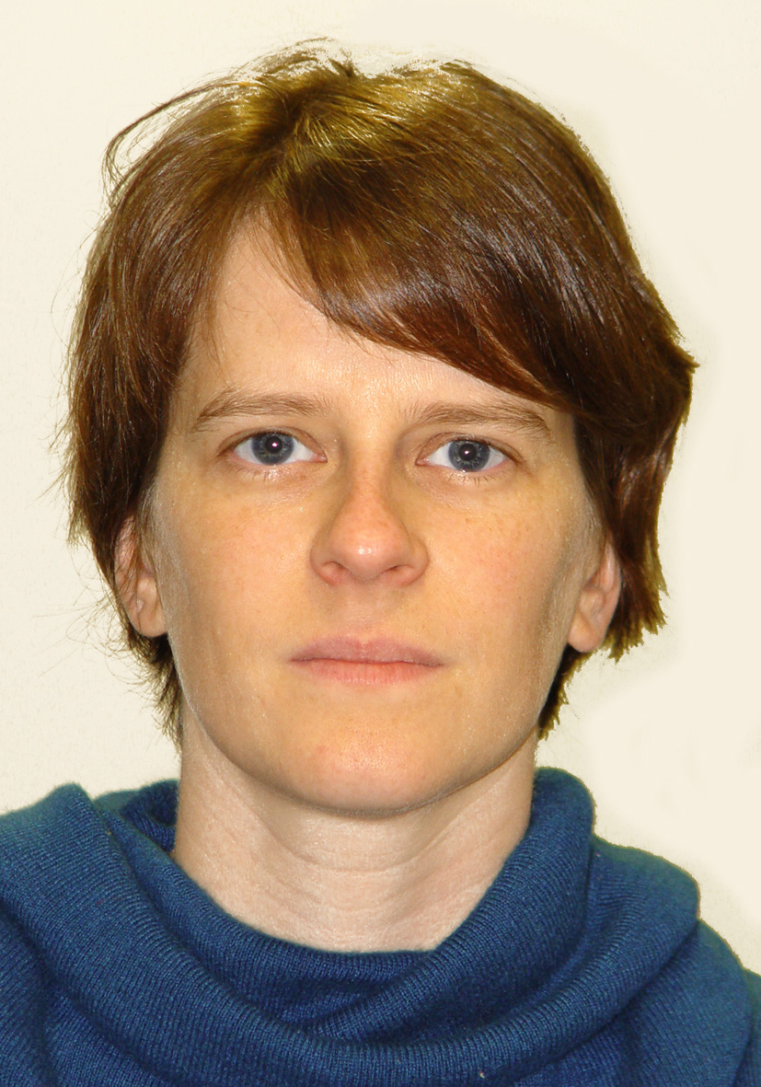
For Help and Advice, please contact:
Safety officer for the 48e building:
Rob Meijers, Building 48e room L107, Tel. 040-89902-243, e-mail: meijers@embl-hamburg.de
Safety Officer for the 25a building:
Annabel Parret, Building 25a room 212, Tel. 040-89902-143, e-mail: parret@embl-hamburg.de
Responsible for the SPC Facility
Maria Garcia, Building 48e room L153, Tel. 040-89902-145, e-mail: garcia@embl-hamburg.de
Responsible for Users laboratory:
Johanna Kallio, Building 48e room L048, Tel. 040-89902-176, e-mail: johanna@embl-hamburg.de
Latest Safety Information available at: http://www.embl-heidelberg.de/LocalInfo/SafetyOffice/
Rob Meijers
Maria Garcia Alai
Johanna Kallio
Annabel Parret

Slide 22
You have completed the Online Briefing
Please follow the link below to a quiz (on site only)
You will need to answer all questions correctly to pass
Safety Quiz (click on or copy and paste this link in your web browser to start)
http://www.embl-hamburg.de/spcsafety/

